Slide 1
PRAGMA 17 – PRAGMA 18
Resources Group

Slide 2
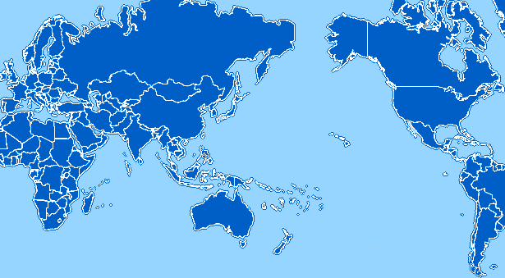
PRAGMA Grid
UZH
Switzerland
UZH
Switzerland
CNIC
China
JLU
China
AIST
OsakaU
UTsukuba
Japan
KISTI
KMU
Korea
Welcome
IoIT-Hanoi
KMU, Korea
Joining PRAGMA grid
LZU
China
SDSC
USA
LZU
China
ASGC
NCHC
Taiwan
UPRM
Puerto Rico
HKU
HongKong
UoHyd
India
CICESE
UNAM
Mexico
ASTI
Philippines
NECTEC
KU
Thailand
CeNAT-ITCR
Costa Rica
HCMUT
HUT
IOIT-Hanoi
IOIT-HCM
Vietnam
MIMOS
USM
Malaysia
UValle
Columbia
IHPC/NGO
NTU
Singapore
MU
Australia
BESTGrid
New Zealand
UChile
Chile
28 institutions in 17 countries/regions, 22 compute sites (+ 7 site in preparation)

Slide 3
Virtualization
Rocks 5.3 with xen roll
  AIST, Japan
    istsvc.hpcc.jp
      Front-end: 12 core / 2CPU (AMD Istanbul), 1TB disk, 8GB memory
      16 nodes: each 12 core / 2CPU (AMD Istanbul), 50GB SSD, 32GB memory
      Used for experiments of VC and HPC Cloud
    Succeeded in installing VCs (Rocks + Xen) and preliminary evaluation is ongoing
  SDSC, USA
    fiji.rocksclusters.org
      Front-end: 8 CPUs, 1TB disk, 2GB memory
      16 nodes: each 1 CPUs, 600GB disk, 23GB memory
      Tested with a VC successful (for tsukuba-gama)
      Add virtual public interface works
      Will be dedicated for PRAGMA grid
    Created EC2 image (Rocks + Bio Roll + Condor), add to a Condor pool
  ASTI, Philippines
    Installed Rocks with Xen roll
    Testing

Slide 4
Applications
Avian Flu Grid (SDSC, USA, continuing)
http://goc.pragma-grid.net/wiki/index.php/Avian_Flu_Grid
  Run on Rocks VM, EC2
  CSF, Gfarm
Brazilian Regional Atmospheric Modelling System (UChile, started)
http://goc.pragma-grid.net/wiki/index.php/Brazilian_Regional_Atmospheric_Modelling_System
  LFC, GFAL, AMGA
Online Document Analysis (IOIT-Hanoi, Vietnam, starting)
http://goc.pragma-grid.net/wiki/index.php/Grid_Oriented_Online_Document_Analysing_System
Volcanic Ash Fall Simulation (ITCR, Costa Rica, preparing)
http://goc.pragma-grid.net/wiki/index.php/NS-TEPHRA
MGrid (KMU, Korea, preparing)
http://pplab.cs.kookmin.ac.kr/xwiki/bin/view/MGrid/WebHome

Slide 5
Tsukuba-GAMA
Geoscience and Resources collaboration
Setup completed
  Tsukuba-gama
  Myproxy
  Naregi-CA
  VOMRS/VOMS
Last mile testing
Start production use by GEO Science Group. Can be used by the other WGs (e.g. Bio)

Slide 6


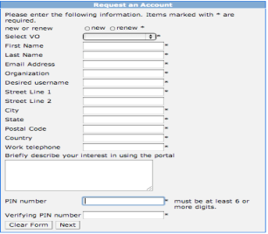






3 steps of Account Management by Tsukuba-GAMA
(1) Account Enrollment: Create accounts and certificates
(1.2) Notification
by email
Yoshio (AIST)
Mason (SDSC)
Peter (GLEON)
(1.1) Request
Account
RA
(Registration Authority)
User
Account Portal
(1.3) Issue
certificates
(1.4) Store
certificates
PRAGMA-GAMA CA
Compute node
Credential
Repository
Stores users’ private keys and certificates
Credential
Repository
Rocks VC @ SDSC
Administrated by Cindy
Frontend node
(2) Registration to PRAGMA VO (and group)
(2.1) Register the user
to PRAGMA VOMS
VO admin: Cindy
Group admin:
- GEO: Ryosuke
- Bio: Wilfred
- …
VO member
DB
VOMS Server

Slide 7

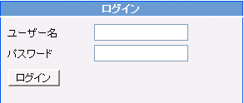
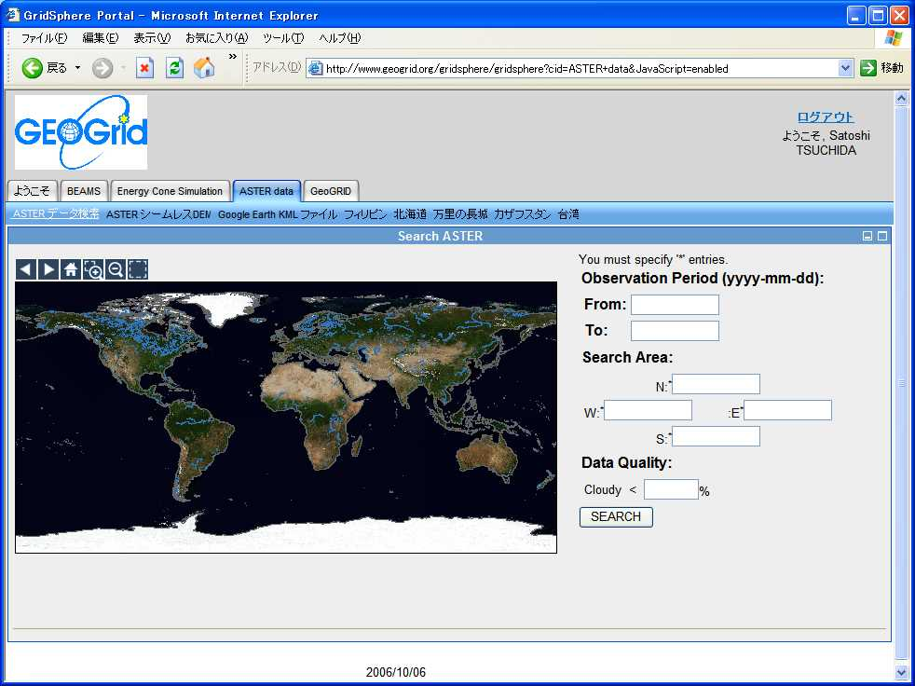
3 steps of Account Management by Tsukuba-GAMA
(3) Use by application portals
Credential
Repository
User
(3.2) Request
VOMS Proxy
(3.1) login by
Username / Password
Credential Repository
(3.5) Send
VOMS Proxy
(3.4) embed
VOMS
extension
(3.3) send
proxy cert.
VO member
DB
GEO portal@AIST
(3.6) VOMS Proxy
on the portal
VOMS Server

Slide 8
Other Infrastructure Projects
Gfarm
  Upgrading to Version 2.3.0
  Ordering hardware for Gfarm storage (SDSC)
    2 x 48TB
VOMS (continuing)
  IOIT-HCM site implementing VOMS

Slide 9
Resource Breakout @ PRAGMA 18
Today
  Status review and the next step of VC-based infrastructure
  Gfarm
Tomorrow
  Tsukuba-GAMA operation
  VOMS sessions
  New topics

